Slide 1
Intro to Git
MBurolla 9/28/2022

Slide 2
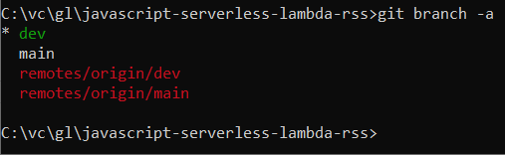
Git: Distributed Version Control
git.exe

Slide 3

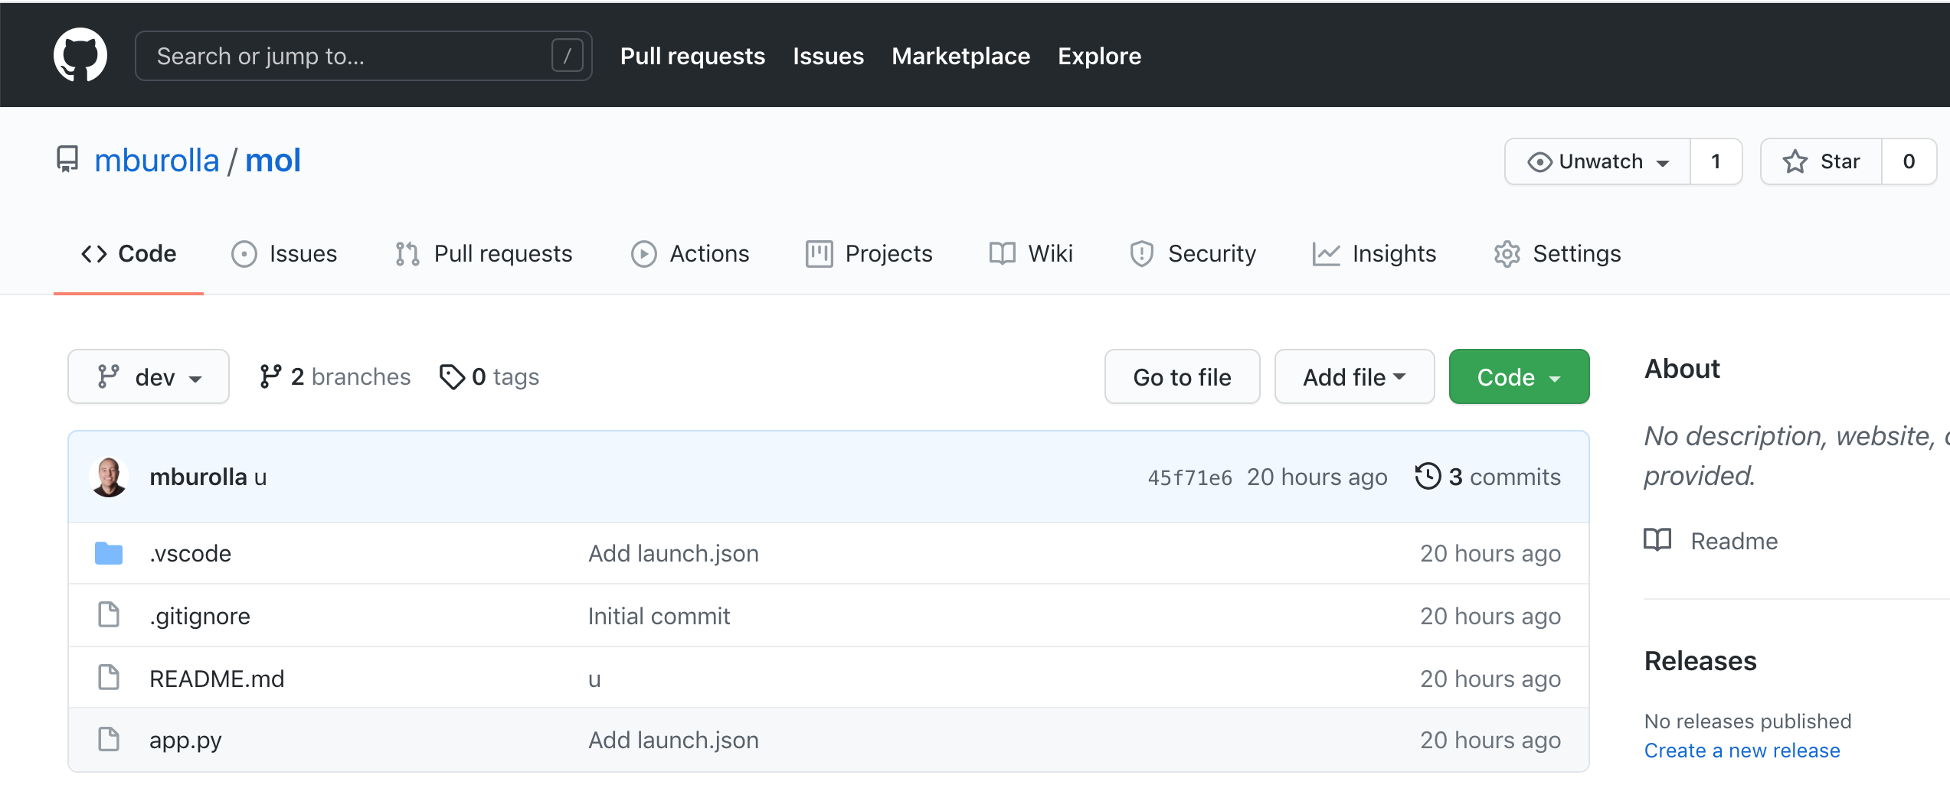
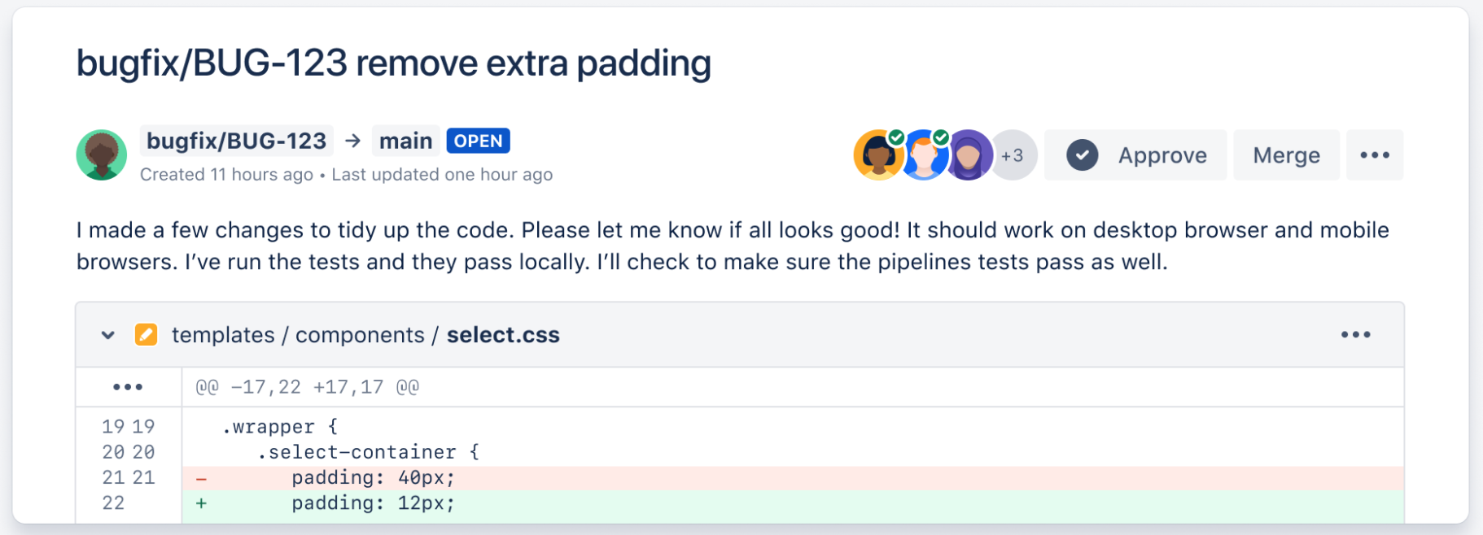

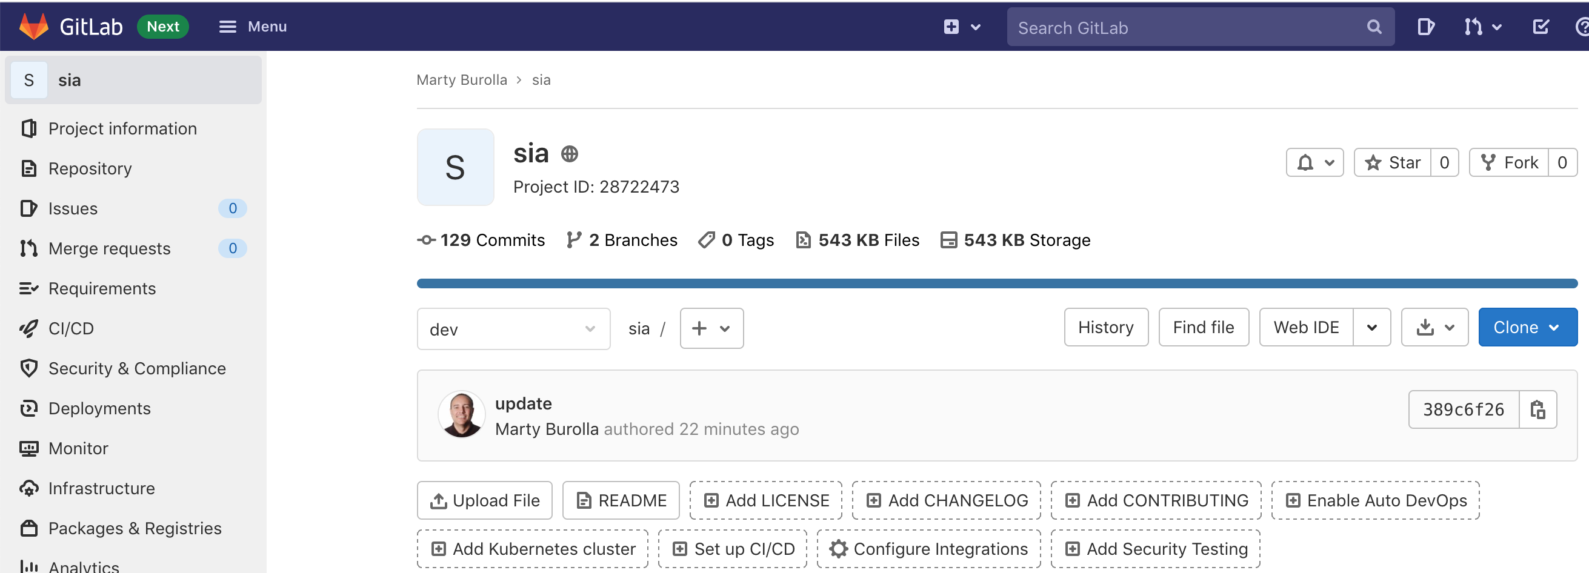
Products That Host Git Repos
git.exe

Slide 4
Git: Distributed Version Control
Remote Git Repo
dev

Slide 5
Git: Distributed Version Control
Generate SSH key pairs
Remote Git Repo
dev

Slide 6
Git: Distributed Version Control
Generate SSH key pairs
Remote Git Repo
Upload public key
dev

Slide 7
Git: Distributed Version Control
SSH
Remote Git Repo
dev

Slide 8
Git: Distributed Version Control
Your Git Repo
Remote Git Repo
Git: Clone
dev
dev

Slide 9
Git: Distributed Version Control
Your Git Repo
Remote Git Repo
dev
dev
dev-{your initials}-{context}
Start some work…

Slide 10
Git: Distributed Version Control
Your Git Repo
Remote Git Repo
dev
dev
dev-mb-fix-login
Start some work…

Slide 11
Git: Distributed Version Control
Your Git Repo
Remote Git Repo
dev
dev
dev-mb-fix-login
Add unit tests…

Slide 12
Git: Distributed Version Control
Your Git Repo
Remote Git Repo
dev
dev
dev-mb-fix-login
Git: Push

Slide 13
Git: Distributed Version Control
Your Git Repo
Remote Git Repo
dev
dev
dev-mb-fix-login
dev-mb-fix-login

Slide 14
Git: Distributed Version Control
Your Git Repo
Remote Git Repo
dev
dev
dev-mb-fix-login
dev-mb-fix-login
You: Create
Pull Request

Slide 15
Git: Distributed Version Control
Your Git Repo
Remote Git Repo
dev
dev
dev-mb-fix-login
dev-mb-fix-login
You: Create
Pull Request
You: I would like to merge my
branch into the dev branch.
Please review my changes.

Slide 16
Git: Distributed Version Control
Your Git Repo
Remote Git Repo
dev
dev
dev-mb-fix-login
dev-mb-fix-login
You: Create
Pull Request
Comments & discussions…

Slide 17
Git: Distributed Version Control
Your Git Repo
Remote Git Repo
dev
dev
dev-mb-fix-login
dev-mb-fix-login
You: Create
Pull Request
Comments & discussions…
ProTip: Never say “you” or “I”

Slide 18

Git: Distributed Version Control
Your Git Repo
Remote Git Repo
dev
dev
dev-mb-fix-login
dev-mb-fix-login
You: Create
Pull Request
Comments & discussions…
ProTip: Never say “you” or “I”

Slide 19
Git: Distributed Version Control
Your Git Repo
Remote Git Repo
dev
dev
dev-mb-fix-login
dev-mb-fix-login
Git: Push
You: Create
Pull Request
Push updates based on
comment and discussions in
Pull Request

Slide 20
Git: Distributed Version Control
Your Git Repo
Remote Git Repo
dev
dev
dev-mb-fix-login
dev-mb-fix-login
You: Create
Pull Request
You: Does everything look ok now?

Slide 21
Git: Distributed Version Control
Your Git Repo
Remote Git Repo
dev
dev
dev-mb-fix-login
dev-mb-fix-login
Pull Request
Accepted

Slide 22
Git: Distributed Version Control
Your Git Repo
Remote Git Repo
dev
dev
dev-mb-fix-login
dev-mb-fix-login
Pull Request
Merged

Slide 23
Git: Distributed Version Control
Your Git Repo
Remote Git Repo
dev
dev
Build kicks off
dev-mb-fix-login
dev-mb-fix-login

Slide 24
Git: Distributed Version Control
Your Git Repo
Remote Git Repo
dev
dev
All unit tests are run
dev-mb-fix-login
dev-mb-fix-login

Slide 25
Git: Distributed Version Control
Your Git Repo
Remote Git Repo
dev
dev
Did all tests pass?
dev-mb-fix-login
dev-mb-fix-login

Slide 26
Git: Distributed Version Control
Your Git Repo
Remote Git Repo
dev
dev
YES
dev-mb-fix-login
dev-mb-fix-login

Slide 27
Git: Distributed Version Control
Your Git Repo
Remote Git Repo
dev
dev
dev-mb-fix-login
dev-mb-fix-login
No reason to keep this branch

Slide 28
Git: Distributed Version Control
Your Git Repo
Remote Git Repo
dev
dev
dev-mb-fix-login
dev-mb-fix-login
We can safely delete it.

Slide 29
Git: Distributed Version Control
Your Git Repo
Remote Git Repo
dev
dev
dev-mb-fix-login

Slide 30
Git: Distributed Version Control
Your Git Repo
Remote Git Repo
But this branch
dev
dev
dev-mb-fix-login

Slide 31
Git: Distributed Version Control
Your Git Repo
Remote Git Repo
But this branch is behind this branch
dev
dev
dev-mb-fix-login

Slide 32
Git: Distributed Version Control
Your Git Repo
Remote Git Repo
dev
dev
Git: Pull
dev-mb-fix-login

Slide 33
Git: Distributed Version Control
Your Git Repo
Remote Git Repo
dev
Updated
dev
dev-mb-fix-login

Slide 34
Git: Distributed Version Control
Your Git Repo
Remote Git Repo
dev
dev
In Sync
dev-mb-fix-login

Slide 35
Git: Distributed Version Control
Your Git Repo
Remote Git Repo
dev
dev
dev-mb-fix-login
No reason to keep this branch

Slide 36
Git: Distributed Version Control
Your Git Repo
Remote Git Repo
dev
dev
dev-mb-fix-login
We can safely delete it

Slide 37
Git: Distributed Version Control
Your Git Repo
Remote Git Repo
dev
dev

Slide 38
Git: Distributed Version Control
Your Git Repo
Repeat
Remote Git Repo
dev
dev

Slide 39
Git Branches and Environments
CI/CD
dev
Development
qa
Testing
prod
Customers

Slide 40
Git Branches and Teams
dev
dev-team-1
dev-team-2
dev-team-3
qa
prod (main/master)

Slide 41
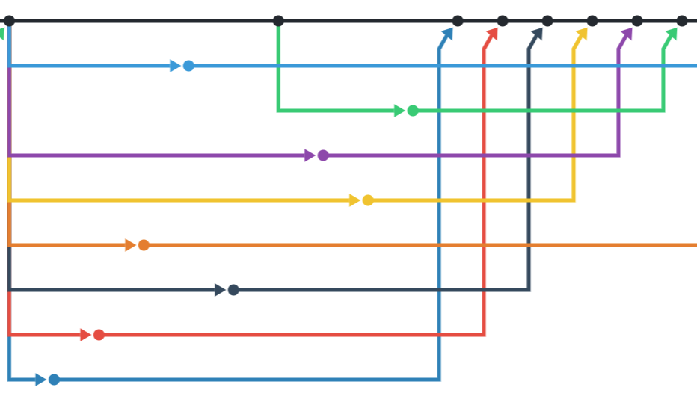
Git Network Graph

Slide 42
Common Git Commands
(In no particular order)
git init
git clone <url>
git fetch —-all
git push origin <branch name>
git pull origin <branch name>
git remote add origin <url>
git add —-all
git branch
git checkout -b <new branch name>
git checkout
git commit -m “your message”
git status
git reset —-hard
git clean -f

Slide 43
Git Cheat Sheet
https://training.github.com/downloads/github-git-cheat-sheet/

Slide 44
Getting Started: Generate SSH Keys
ssh-keygen
Upload public key to your GitHub account. NEVER share your private key!

